Slide 1

Employee Management System
Anshul
Avneesh kaushik

Slide 2
Abstract
Title: Employee Management System(EMS) using Hibernate, Java, MySQL
Objective: Enable seamless CRUD operations for 6 essential entities: Employee, Manager, Project, Department, Attendance, Salary.
Tech Stack: Java, Hibernate, MySQL, Eclipse IDE.
Key Features: Streamlined operations, integrated data management, intuitive user interface.
Benefits: Enhances operational efficiency, ensures data integrity, supports scalability.
Conclusion: Empowers organizations with modern tech solutions for efficient employee management.
Future Scope: Integration of additional modules, users on different authorization level ,that is, employees can also access the system with limited task.

Slide 3
Introduction
The Employee Management System is a Java-based application designed to simplify administrative tasks related to employee management.
It offers functionalities for managing employees, managers, projects, departments, attendance, and salaries which are essentials in a employee management.
Built using Java, Hibernate, MySQL, and Eclipse, it provides CRUD operations for all entities, enabling seamless handling of employee data.
With its user-friendly interface, the system enhances operational efficiency by automating routine tasks and providing timely access to accurate employee information.

Slide 4
What is EMS?
Employee Management System is a application developed to maintain the details of employee and related entities(Department, Projects, etc) within in an organisation using Hibernate.
The EMS has been developed to override the problems prevailing in the practising manual system.
It maintains the information about the personal and official detail of employees.
This project aims to simplify the task of maintaining records of the employees of a company.
It also aims to develop a well designed database to store employee information.
This application works as user interface for database of a company , It simplifies the interaction between the database and the user(Administrator of company).

Slide 5
Why Choose Hibernate?
Simplified Data Persistence: Hibernate provides a simplified approach to handling database interactions, reducing the need for manual SQL queries.
Object-Relational Mapping (ORM) Framework: Eliminates the need for writing boilerplate JDBC code, enhancing developer productivity.
Automatic Schema Generation: Automatically generate database schemas based on Java entity classes.
Caching Mechanism: Incorporates a robust caching mechanism to optimize application performance.
Transaction Management: Simplifies transaction handling.

Slide 6
Entities
This application encompasses six entities for operational functionality
Department
Manager
Project
Salary
Attendance

Slide 7
Responsibilities
There are six entities and two of us is responsible for developing three entities each.
Anshul :
Employee
Salary
Attendance
Avneesh Kaushik :
Department
Manager
Project

Slide 8
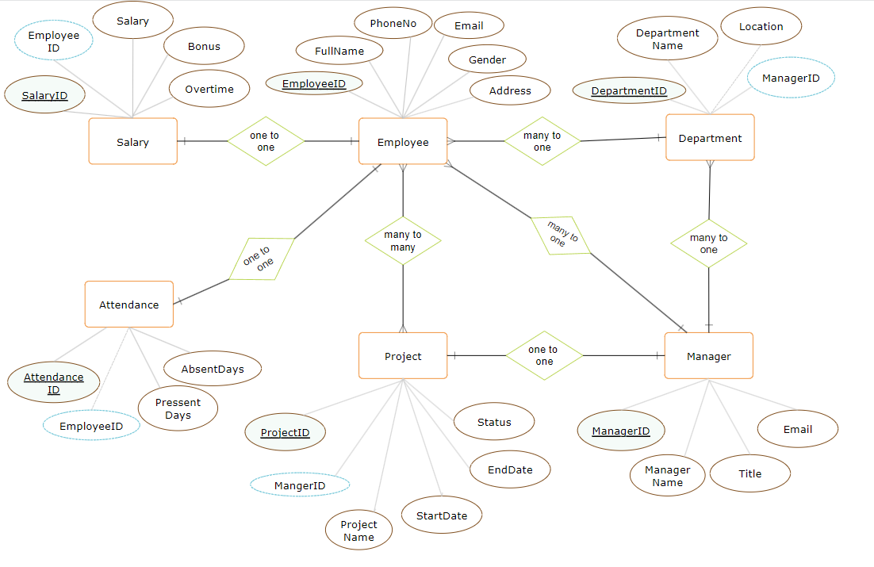
ER Diagram

Slide 9
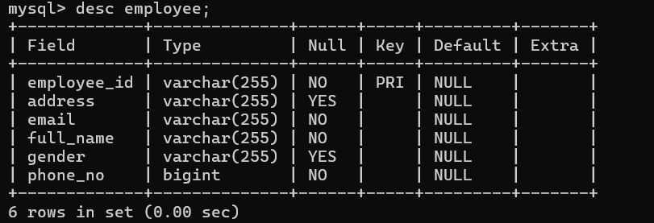
Database Design
1. Employee

Slide 10
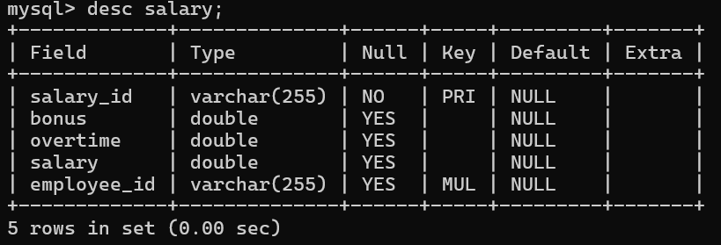
Database Design
2. Salary

Slide 11
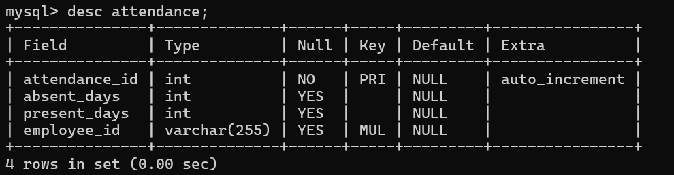
Database Design
3. Attendance

Slide 12
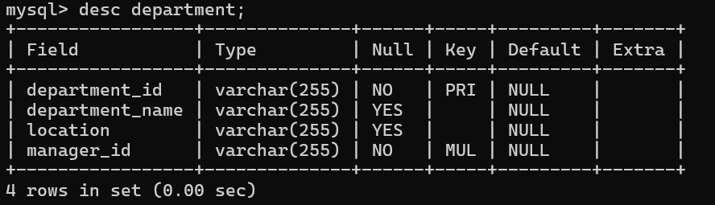
Database Design
4. Department

Slide 13
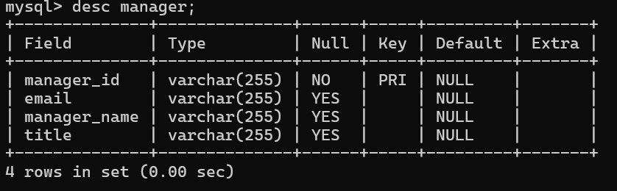
Database Design
5. Manager

Slide 14
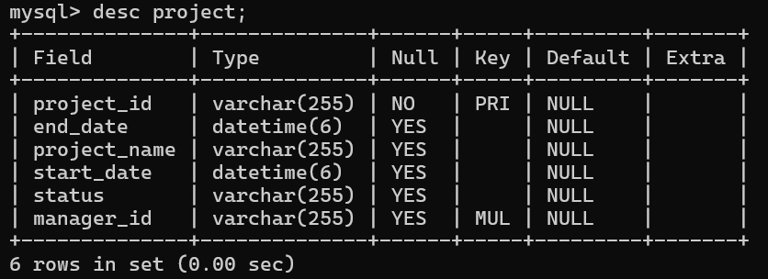
Database Design
6. Project

Slide 15
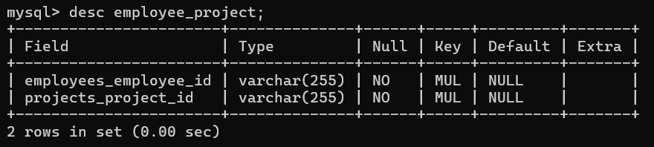
Database Design
7. Employee_Project
This table is created by the system itself to store the foreign keys of both the tables as there is a ManyToMany relationship between these two entities.

Slide 16
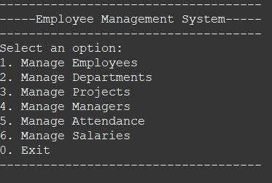

User Interface
This applicartion is console based application so the UI has been designed to take input and display outputs on the console itself only.
The fig here shows the first message displayed in form of menu.
You must select an option from these menu to proceed further.
After you select an option the connection to database is established.

Slide 17
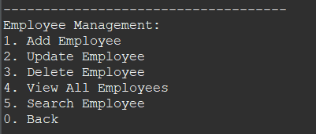
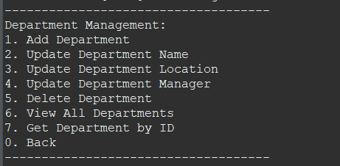
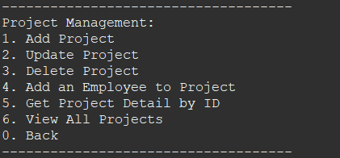
User Interface
Lets see what happens when you choose different options from the Main menu.
1.
2.
3.

Slide 18
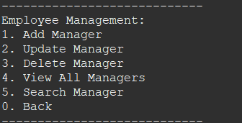
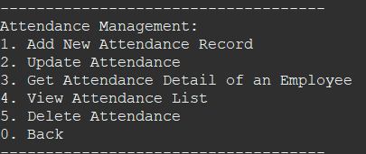
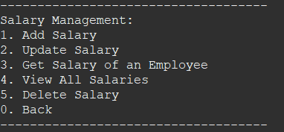

Continued..
4.
5.
6.
0.

Slide 19
Backend
The backend of this application is developed using Java, Hibernate integrating MySQL for database.
This project implements all the basic concepts of Java.
The implementation is hidden by using interfaces, exceptions handled using try catch blocks.
Try with resources and Custom Exception class has also been used in this project to make it more efficient and error free.
HQL used to retrieve data from database.
App.java contains the main class of this application.

Slide 20
Backend Contd..
There are six packages in this project which performs all the task
com.ems.app :- Contains App.java which has main method.
com.ems.entities :- Contains all six entity class.
com.ems.service :- Contains Interfaces which have declarations of all methods.
com.ems.serviceImpl :- Contains implementation of methods.
com,ems.operations :- Contains classes which manages these methods for an entity.
com.ems.customexceptions :- Contains custom exception classes.`

Slide 21
THANK YOU

